Slide 1

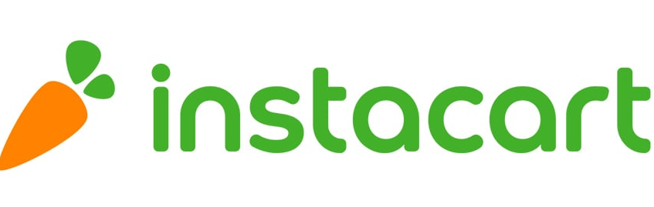

InstaCart Customer Insights: Behavior and Clusters Addi Wei 706-386-6054

Slide 2
Topics
Objectives: Know Your Customer
Data Collection / Dataframe Study
Best Selling Products & Departments
Best Customers
Clustering – Feature Engineering
Word2Vec / Word Embeddings
Customer Clusters
Conclusion / Next Steps

Slide 3
Objectives: Know your customer
What are the top selling products?
Which Departments are doing best?
Who are the top 30 customers?
When are they buying (days of the week, hours of the day)
Ordering Frequency
How can we cluster customers to optimize our marketing strategy?
Customer Buying Behavior
Customer Clusters

Slide 4
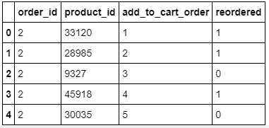
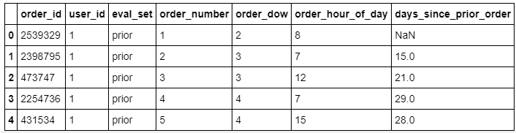
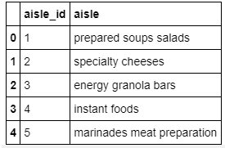
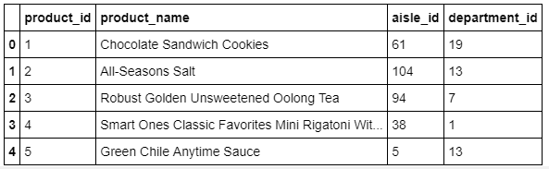
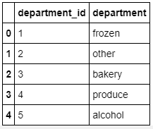
Data Collection / Dataframe Study
Orders
Prior Orders
Previous orders and orders are tied by order_id
Products

Slide 5
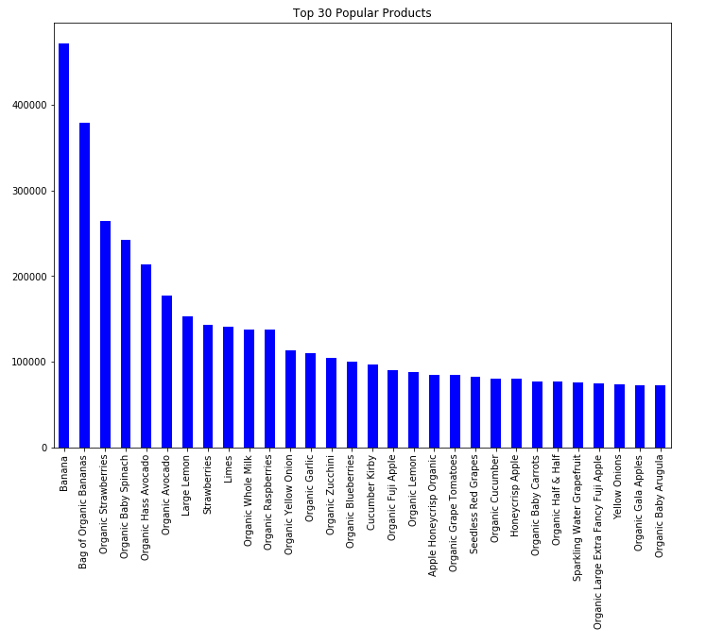
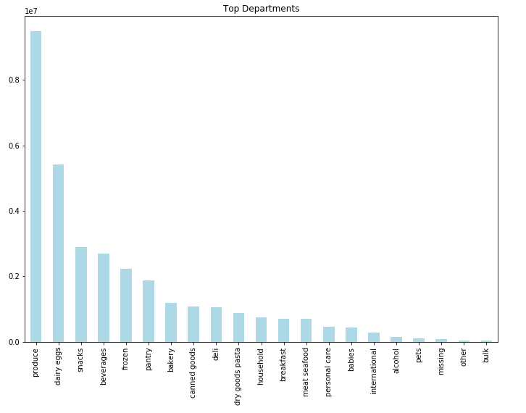
Top Selling Products & Departments

Slide 6

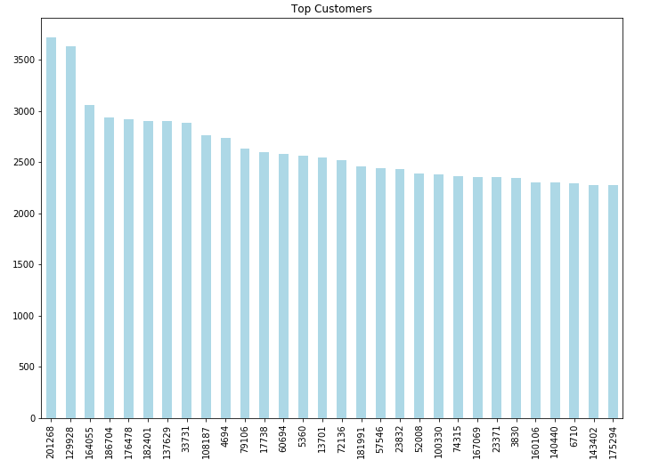
Best Customers
Marketing / Promotional Activity for these Top 30 customers

Slide 7
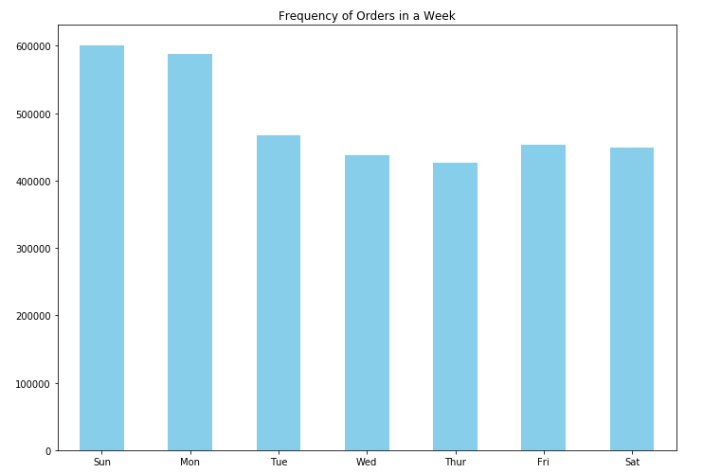
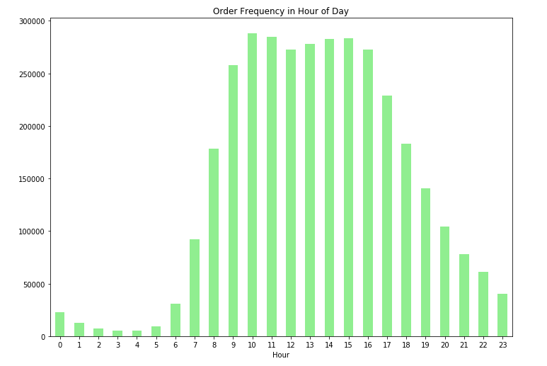
When are Customers Buying?
A lot of sales on Sunday and Monday – families are restocking for the week
Predominately selling during the business hours in daytime

Slide 8
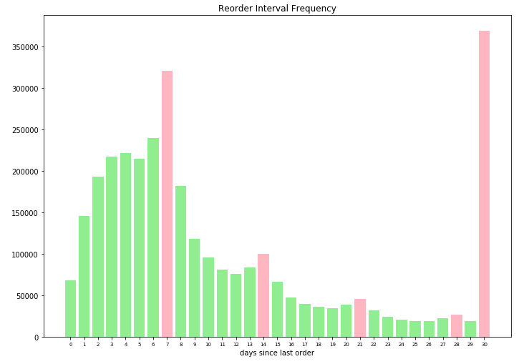
Order Frequency
Weekly Ordering Pattern Observed
Spike at 30 – this could be a bucketized amount (meaning 30 captures all values > 30)

Slide 9
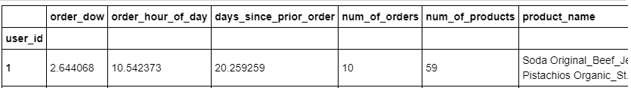
Clustering
Feature Engineering of Users
Average utilized for day of week, order hour of day, days since prior order
Utilize Word2Vec to embed product name / unstructured data
Since customers will buy different products, these different numbers will cause a dimension mismatch
Utilized average of the word vectors for a 50 column representation

Slide 10
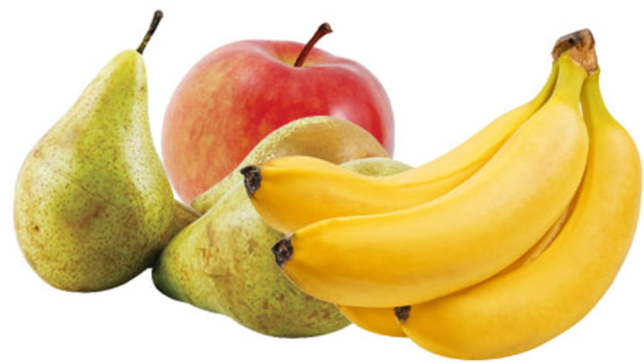
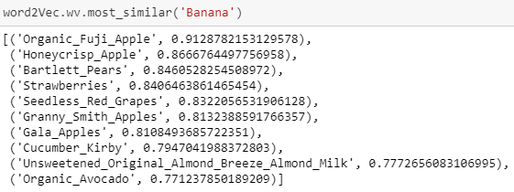
Word2Vec – cont’ed
W2V results: Similar product ‘Banana’ – How about apples and pears?

Slide 11
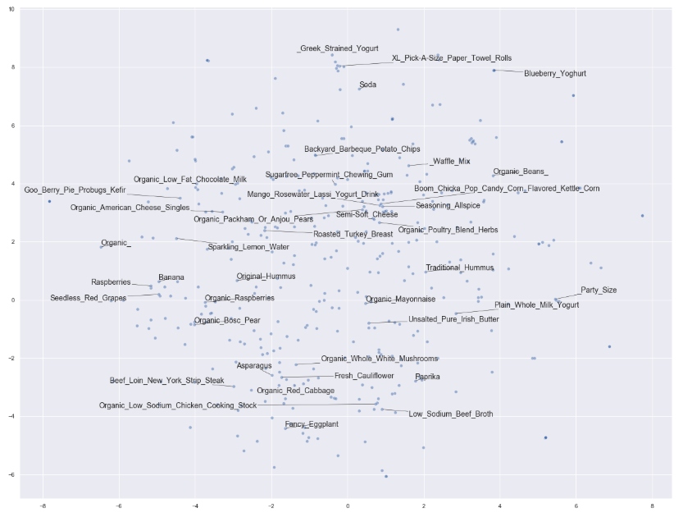
Word2Vec – cont’ed
Milk, Cheese (Orange Circle)
Butter, yogurt, mayonnaise (Blue circle)
Fruits (Red circle)

Slide 12
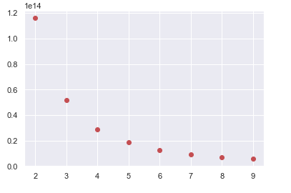
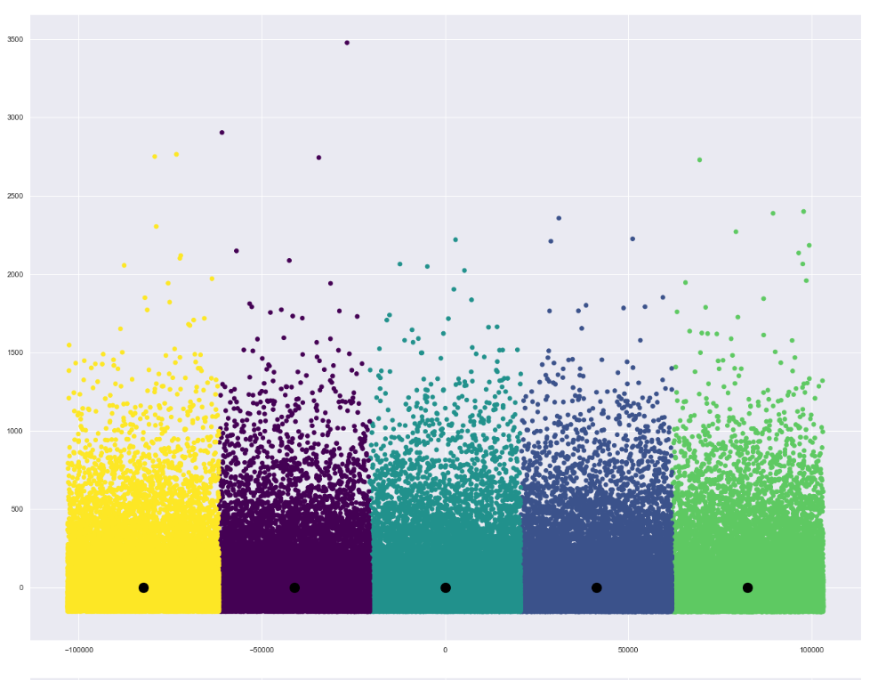
Kmeans Clustering – Unsupervised Learning Problem
Utilized elbow method to select k = 5
5 very discrete clusters – minimal overlap which is good

Slide 13
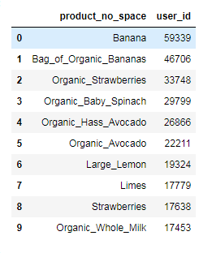
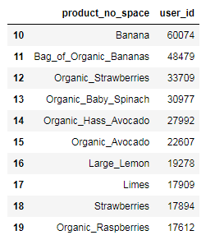
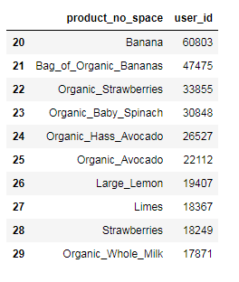
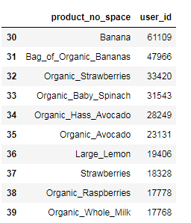
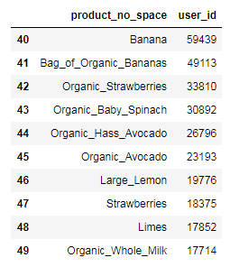


Cluster Buying Behavior
1
2
3
4
5
Nothing interesting so far….

Slide 14
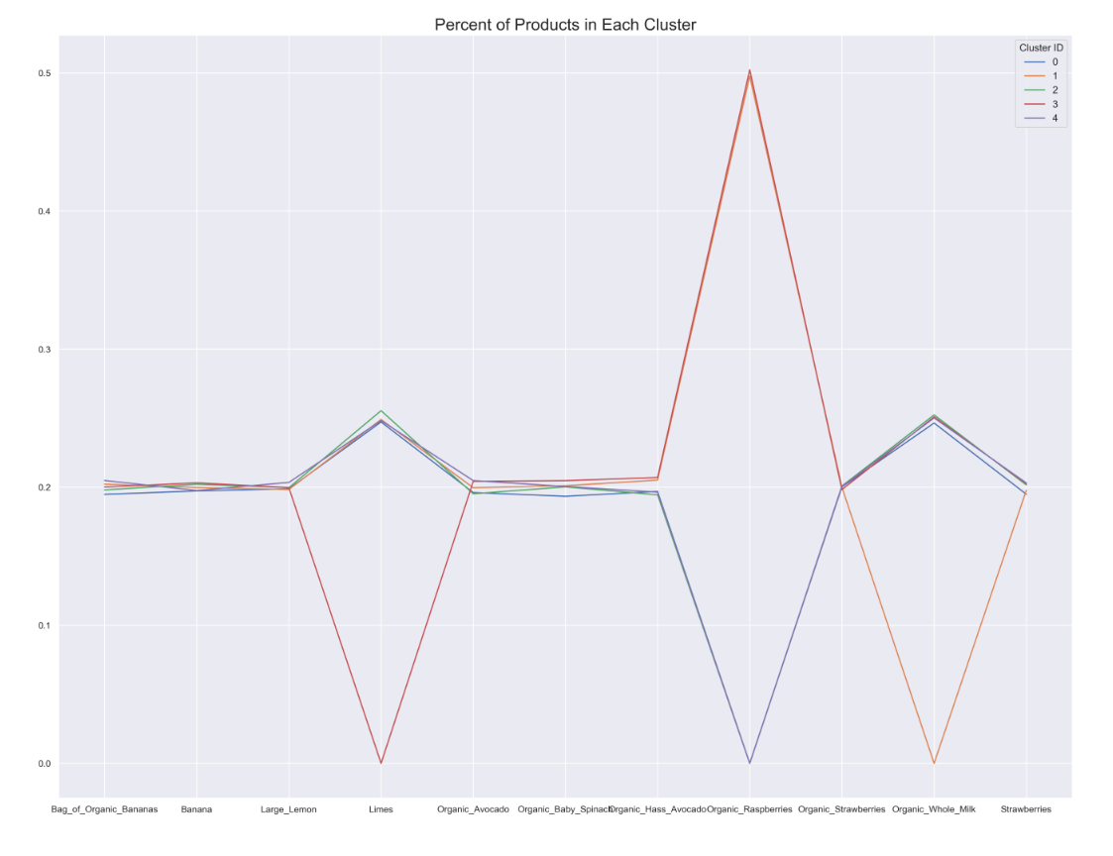
Cluster Buying Behavior
Cluster 1 buys a lot raspberries
Cluster 4 buyers no raspberries
Cluster 3 buys no limes
Cluster 1 buys no milk – lactose intolerant?
Clustering helped us see a group of customers
that do not buy milk and a set of customers buying a lot
of rasberries

Slide 15
Conclusion / Next Steps
Clustering helped us identify:
Bananas are figuratively the bread and butter of every cluster (who doesn’t eat bananas?)
Group of customers possibly allergic to milk
Cluster of customers not buying any limes, rasberries– they don’t like the sour taste perhaps
Next Steps:
Study additional clustering distinctions
Obtain additional data from our customers if possible (sex, age, location)
Improve unstructured data process / clean up, consider BoW, and other features
Predictions: Feature engineering on products, users, products + users to predict purchased product
Models: Random Forest, Xgboost, Neural network
Model Selection Criteria:
1) Training Efficiency
2) High Accuracy
3) Hyper parameter tuning pros and cons

